Slide 1
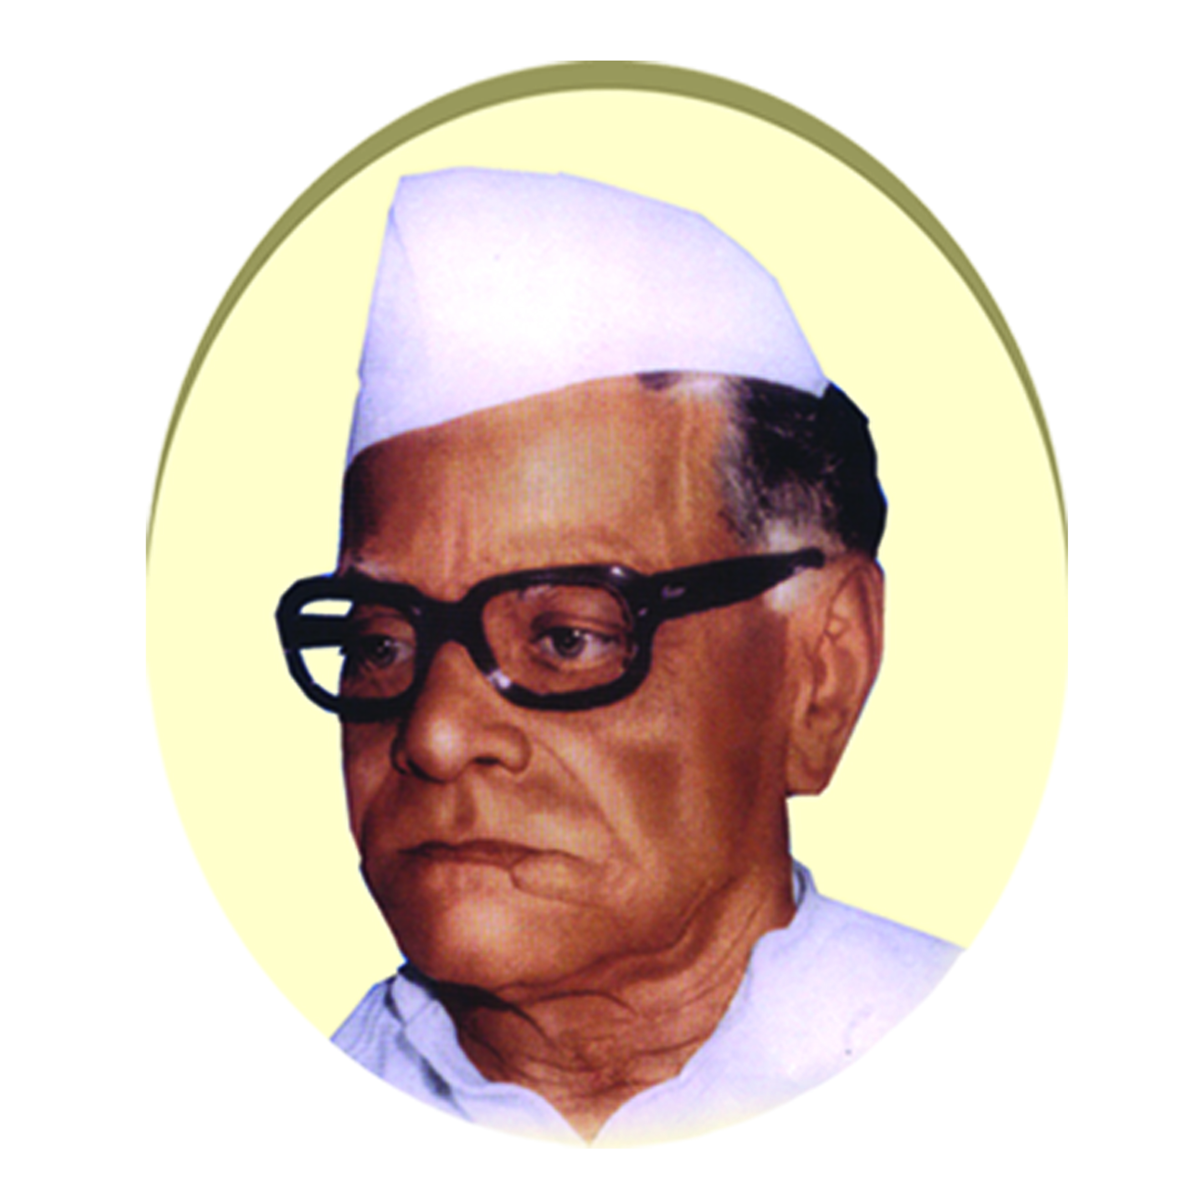
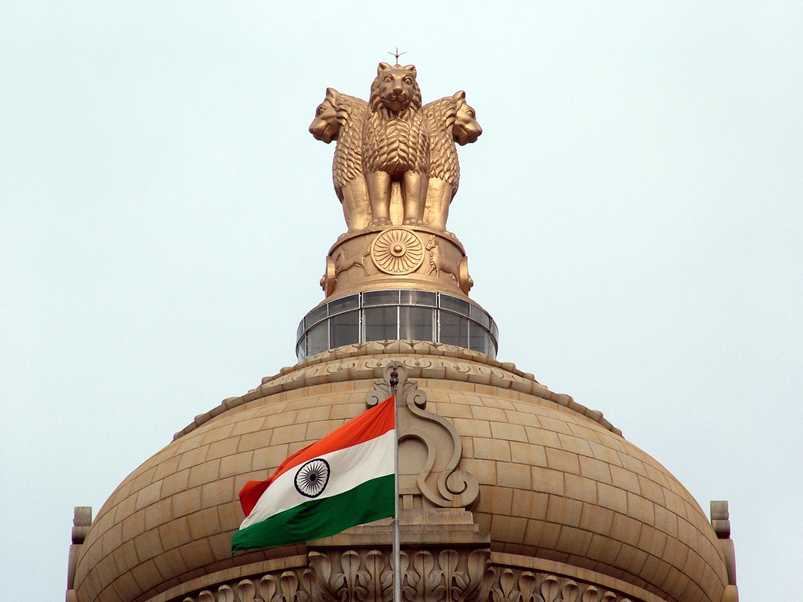
WELCOME TO DEPARTMENT OF POLITICAL SCIENCE (Establishment:1973)
Janata Shikshan Sanstha’s
KISAN VEER MAHAVIDYALAYA, WAI.

Slide 2
WELCOME PEER TEAM
HON. PROF. MOHAMMED BASHEER
(Chairperson)Vice Chancellor,
Calicut University, Kerala.
HON. PROF. MUSHTAQ AHAMAD DARZI
(Member Co-ordinator)Department of Management Studies,
University of Kashmir Hazratbak, Srinagar, Jammu & Kashmir
HON. DR. GIRISH KUCHINAD
(Member) Former Principal,
Dr. A..V. Baliga College of Arts and Science, Kumta, Karnataka

Slide 3
Vision of Department
To Bring attention of the students towards the current national and international political situations.
To inculcate democratic and secular values among the students
To Make the students responsible Indian citizens
To create awareness about the Indian Constitution among the students
To make aware about social, political, cultural and economic issues of the India and world.

Slide 4
OBJECTIVES OF THE DEPARTMENT
To understand the history of political ideology and political thoughts from ancient to the modern age.
To understand the major political system in the world.
To understand the dimensions of international politics.
To interpret the role of regional and international organization in the new world order.
To analyze the concept of good governance and e-governance.
To realize the organs of government machinery and representation.
To understand the formulation, execution, decisions and laws made by the government.
To understand the Indian parliamentary political process.

Slide 5
INFRASTRUCTURE
Department of Political Science – (10x10)100 sq. ft.
Class Room B.A.I (30x30) 900 sq. ft.
Class Room B.A.II (30x30) 900 sq. ft.
Class Room B.A.III (30x30) 900 sq. ft.
Sr. No. | Nature of Equipment/Tools | Total Number
1. | Cupboard | 1
2. | Chairs | 6
3. | Table | 1
4. | Book Stand | 1
5. | Maps | 2
6. | Photos | 6
7. | Watch | 1
8. | LED Tube Light | 1
9. | Table Fan | 1

Slide 6
COURSES
Class | Semester | Title of Paper | Paper No. | Marks | Syllabus Introduced Year
B.A. Part I Political Science | Semester-I | Indian Government | Paper-I | 50 | June 2013 to 2018 onwards
 | Semester-II | Political Process in India | Paper-II | 50
B.A. Part I Political Science | Semester-I | Introduction to Political Science | Paper-I | 50 | CBCS Pattern June 2018 onwards
 | Semester-II | Indian Constitution | Paper-II | 50
B.A. Part II Political Science | Semester-III | Basic Concept of Political Science | Paper-III | 50 | June 2014 onwards
 |  | Ancient Indian Political thought | Paper-IV | 50
 | Semester-IV | Local Self Government and Movements in Maharashtra | Paper-V | 50
 |  | Modern Indian Political thought | Paper-VI | 50
B.A. Part III (Spl.) Political Science | Sem. ‐ V | Modern Government | Paper ‐ VII | 50 | June 2015 onwards
 |  | Public Administration | Paper VIII | 50
 |  | International Politics | Paper No. IX | 50
 |  | Constitution of United States of America | Paper No. X | 50
 |  | Classical Western Political Thought | Paper No. XI | 50
 | Semester VI | Modern Political Concepts | Paper - XII | 50
 |  | Administrative Thinkers | Paper ‐ XIV | 50
 |  | Foreign Policy of India | Paper No. XV | 50
 |  | Constitution of China and Sweden | Paper XVI | 50
 |  | Modern Western Political Thought | Paper XIV (Practical Paper ‐ II) | 50

Slide 7
UNIQUE FEATURES
ADD-ON COURSE- POLITICAL SCIENCE FOR COMPETITIVE EXAM
DEPARTMENTAL LIBRARY
MENTOR-WARD SCHEME
USE OF SOCIAL MEDIA
INTERNET FACILITY
INSTITUTIONAL LEVEL WORKSHOPS
PARTICIPATION OF THE STUDENTS IN RESEARCH ACTIVITIES
CONTINUOUS INTERNAL EVALUATION

Slide 8
Department at a Glance
Year of Establishment : 1973
Courses Offered : B.A. I, II, III
Number of Faculties : 02 (C.H.B.)
STUDENT STRENGTH
Year | B.A.I | B.A.II | B.A.III
2013-14 | 145 | 57 | 66
2014-15 | 172 | 53 | 47
2015-16 | 117 | 91 | 32
2016-17 | 149 | 63 | 54
2017-18 | 139 | 47 | 40

Slide 9
Teaching Faculty
Name | Designation | Qualification | Experience ( in years)
Mr. R. S. Jaykar | Assistant Professor | M.A., B.Ed., SET Political Science | 06
Mr.K. A. Kajale | Assistant Professor | M.A., SET, NET Political Science | 03

Slide 10
STUDENTS CENTERED ACTIVITIES
Students of Political Science Participate in :
Study Tours
Field Visits
Group
Discussion
Quiz Sessions
Students Seminars
Project Work
Guest
Lectures
Work
Shops

Slide 11
TEACHING METHODS
Lecture Method
Seminar Workshop
Group Discussion
Study Tours
Poster Presentation
Question – Answer Method

Slide 12
METHODS OF EVALUATION
Diagnostic test
Observation
Result Analysis
Home Assignments
Random test
Annual exam
Student and Parents Feedback

Slide 13
DEPARTMENTAL RESULT ANALYSIS
Sr. No. | Year | Total no. of students appeared | Dist. | First Class | Second Class | Pass Class | Total Pass
1 | 2013-14 | 66 | 4.54% | 15.15% | 60.60 % | 00.00% | 80.29%
2 | 2014-15 | 47 | 5.27% | 24.57% | 33.33% | 00.00% | 64.91%
3 | 2015-16 | 32 | 00.00% | 10.00% | 80.00% | 00.00% | 90.00%
4 | 2016-17 | 54 | 5.55% | 9.25% | 60.11 | 00.00% | 75.91%
5 | 2017-18 | 40 | 15.00% | 15.00% | 47.50% | 00.00% | 77.50%

Slide 14
MERITORIOUS STUDENTS
Sr. No. | Name of Student | Year | Class | % of Marks
1. | Dalavi Aasha Shivaji | 2013-14 | B.A.III | 72.55
2. | Doke Baliram Shivaji | 2014-15 | B.A.III | 78.00
3. | Chavan Priyanka Dilip | 2015-16 | B.A.III | 65.50
4. | Gaikwad Supriya Sanjay | 2016-17 | B.A.III | 78.39
5. | Vare Mohini Maruti | 2017-18 | B.A.III | 82.66

Slide 15
FACULTY PARTICIPATION IN CONFERENCES & SYMPOSIA
Sr.No. | Name of the Teacher | Name of Conferences. | Sponsoring Agency | Place and Date
1 | Prof. R.D.Dubal | Dr. B. R. Ambedkar: Indian Constitution and Society | Chh.Shivaji college Satara | 10 Feb. 2016 Satara
2 |  | Working and Recruitment in RBI | Kisan Veer Mahavidyalaya wai | 29 Jan.2015 wai
3 |  | Shivaji University Political Science Association Conferences | Mudhoji College Phaltan | 22,23 March 2015 Phaltan
4 | Prof. R.S.Jaykar | Challenges Before Women Empowerment | Y.C.Mahavidyalaya Pachwad | 24 March 2015 Pachwad
5 |  | Contribution of Dr.B.R. Ambedkar to Development of Modern India | Shivaji University Kolhapur | 12,13 Jan. 2017 Kolhapur
6 |  | Unsung Heroes of Indian Freedom Movement | Kisan Veer Mahavidyalaya Wai | 23 Feb.2017 Wai
7 |  | Recent Trends In Commerce Management and Economics | Kisan Veer Mahavidyalaya Wai | 23 Dec.2017 Wai

Slide 16
Add on Course: Short Term Course on Political Science for Competitive Exams
Self Funded Course | Short Term Course on Political Science for Competitive Exams | 100 Marks | June 2015 onwards
Sr. No. | Particulars | 2015-16 | 2016-17 | 2017-18
1 | Total Number of Students | 32 | 54 | 40
2 | No. of Students Appeared | 30 | 51 | 38
3 | No. of Students Absent | 02 | 03 | 02
 | a)Distinction | 20 | 28 | 25
 | b)First Class | 09 | 20 | 10
 | c) Second Class | 01 | 03 | 03
 | d) Pass Class | - | - | -
5 | No. of Students Failed | - | - | -
6 | No. of Students ATKT | - | - | -
7 | Percentage of Passing | 100% | 100% | 100%

Slide 17
AWARDS / ACHIEVEMENTS
Sport Achievement
Miss. Hirave Janabai Dhondiba (B.A.III 2015-16)
• Satara Hill marathon (2015) 1st Rank
• Inter railway All India Cross Country (2015) 2nd Rank
• Satara Hill marathon (2016) 2nd Rank
• Inter railway All India Cross Country (2016) 1st Rank
• Goa Marathon (2014) 1st Rank

Slide 18
AWARDS / ACHIEVEMENTS
University Ranker
Miss. Vare Mohini Maruti (B.A.III 2017-18)
• Shivaji University Merit Scholarship for B.A.III Exam held in March 2018

Slide 19
PLACEMENT OF DEPARTMENTAL STUDENT
Sr. No. | NAME OF THE STUDENT | YEAR JOINING | DESIGNATION | PLACE OF WORK
1. | SAWANT ASHLESHA ANIL | 2014 | Assistant Professor | Kisan Veer Mahavidyalaya. Wai.
2. | JAYKAR RAJENDRA SHARAD | 2014 | Assistant Professor | Kisan Veer Mahavidyalaya. Wai.
3. | JAIGUDE SAGAR CHANDRAKANT | 2015 | Clark | Wai Urban Bank, Wai.
4. | BHOSALE SANTOSH NARAYAN | 2015 | GD | Indian Army
5. | KHARE SUYOG BHAGVAN | 2016 | Clark | Kisan Veer Sugar Factory, BHuinj.
6. | HIRAVE JANABAI DHONDIBA | 2016 | TC | Indian Railway
7. | BHOSALE YOGESH SAMBHAJI | 2017 | GD | Indian Army
8. | CHAVAN POOJA RAJENDRA | 2017 | Clark | Bhumi Abhilekh Office,Wai
9. | SHINGTE PALLAVI SANJAY | 2017 | Teacher | Disha Public School, Wai.
10. | MAHANGADE MAYURI HANMANT | 2017 | Teacher | Disha Public School, Wai.
11. | GAIKWAD POOJA MOHAN | 2017 | Teacher | Sidharth Public School Wai
12. | MASKE KADAMBARI GOWARDHAN | 2017 | Teacher | Mahila Mandal Public School Wai
13. | PINJARI AZHAR HAMJU | 2017 | Interior Designer | Metro Furniture Factory
14. | JAMDADE PRATIK GULAB | 2018 | Peon | Kisan Veer Mahavidyalaya, Wai.
15. | SHINDE KIRAN VITTHAL | 2018 | Peon | Kisan Veer Mahavidyalaya, Wai.

Slide 20
DEPARTMENTAL PARTICIPATION IN NSS/NCC/SPORTS
Sr. No. | Year | Name of the Student | Class | Certificate
1. | 2016 | Hirave Janabai Dhondiba | B.A.III | Sport (Athletics)
2. | 2017 | Nanavare Snehanjali Rajendra | B.A.II | Sport (Field Archery)
3. | 2017 | Kharat Manisha Rajaram | B.A.III | N.S.S.
4. | 2017 | Jadhav Prakash Sunil | B.A.III | N.C.C.
5. | 2018 | Suryawanshi Nilesh Sadanand | B.A.III | N.S.S.

Slide 21
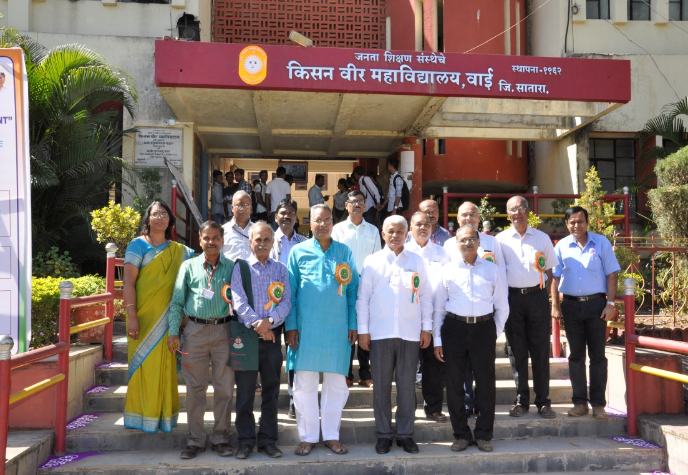
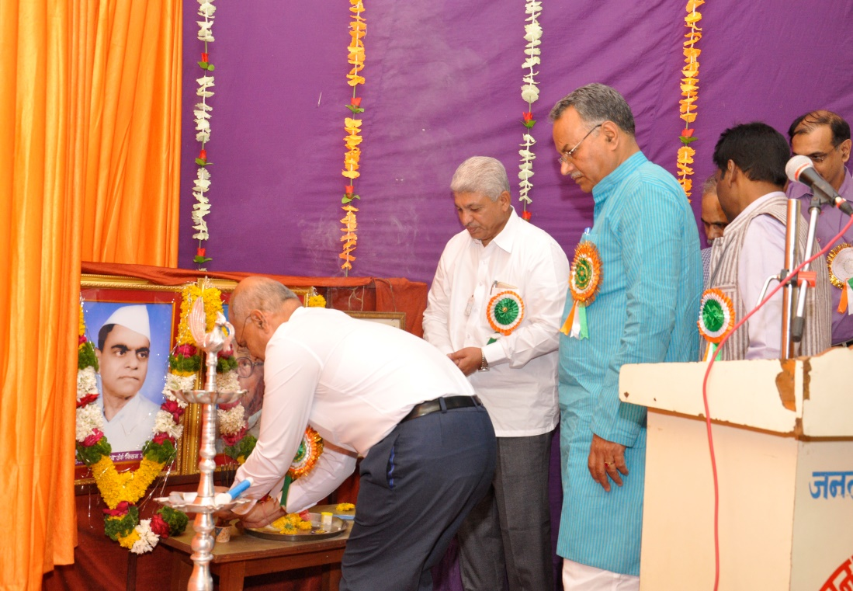
PROGRAMMES ORGANISED BY DEPARTMENT
ONE DAY NATIONAL SYMPOSIUM
‘UNSUNG HEROES OF INDIAN FREEDOM MOVEMENT’
23rd February 2017

Slide 22
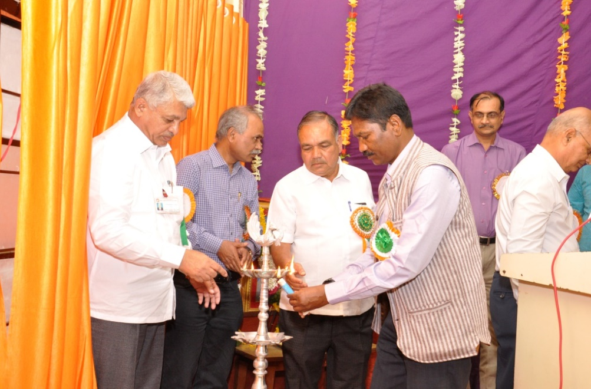
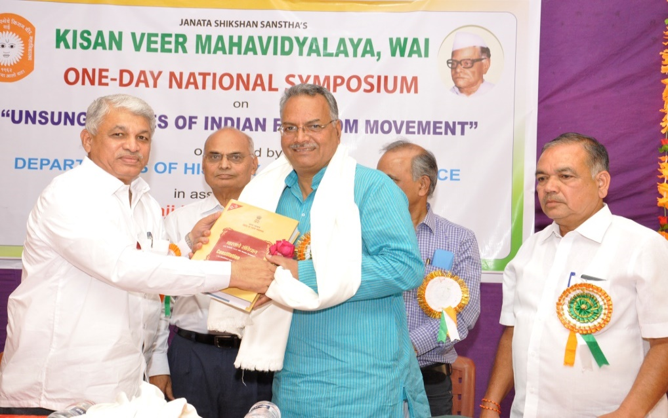
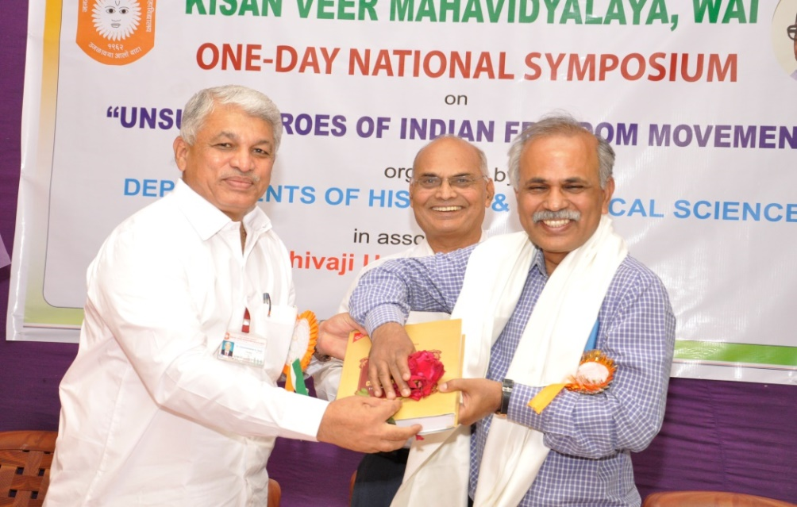
ONE DAY NATIONAL SYMPOSIUM

Slide 23
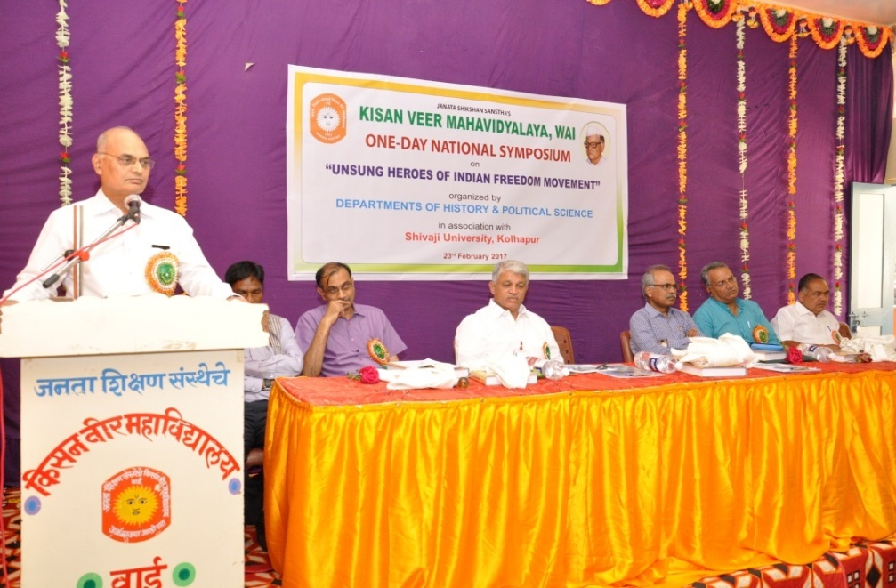
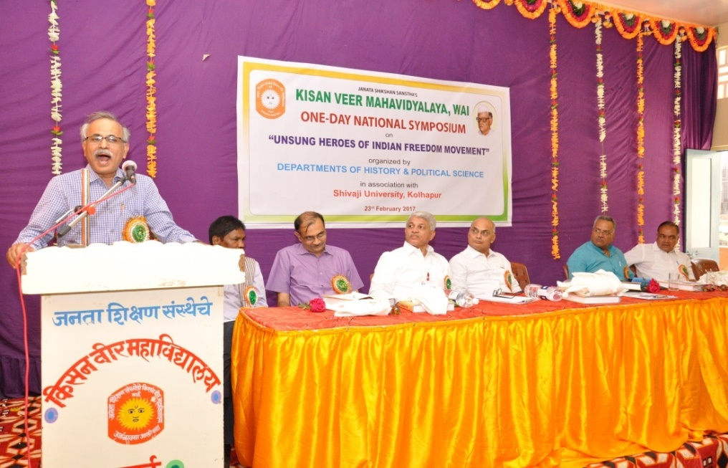
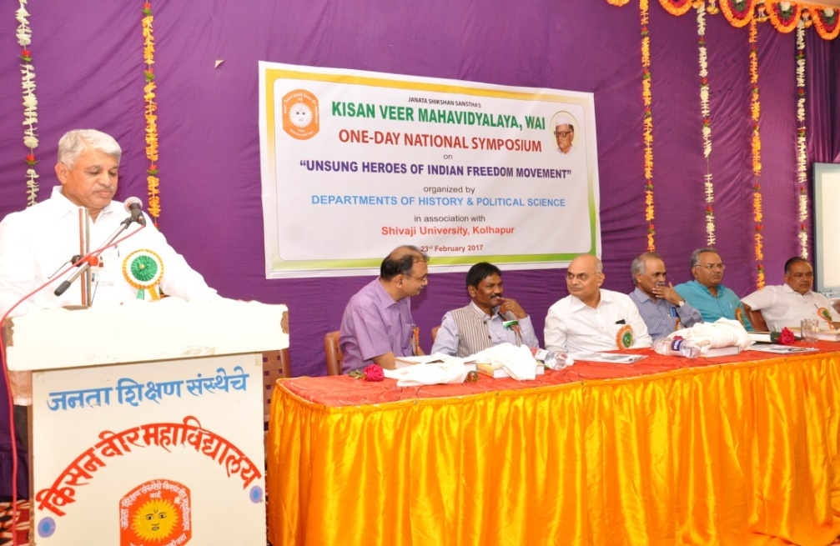
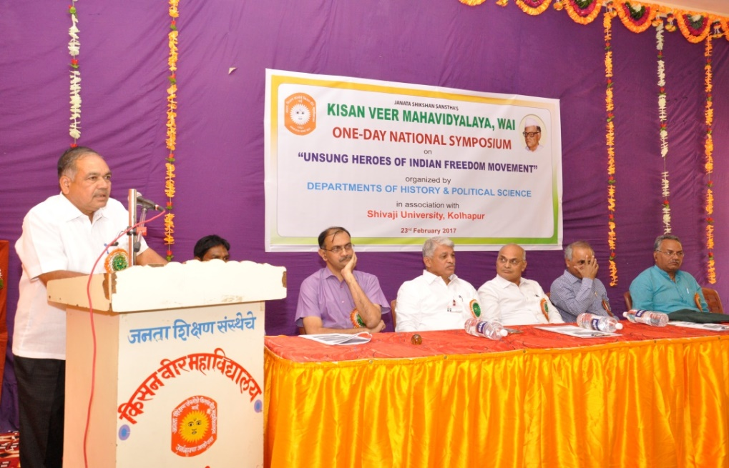

Slide 24
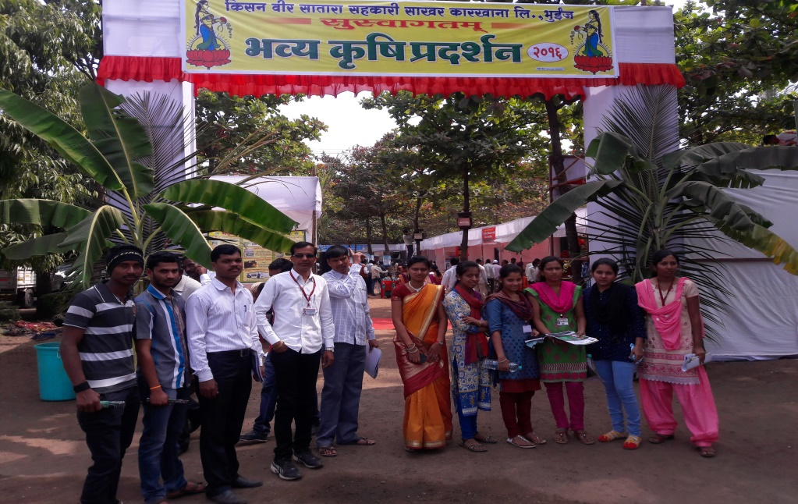
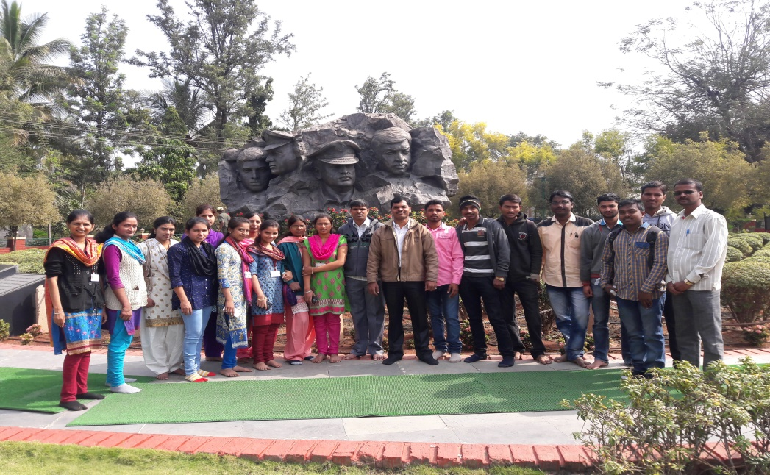
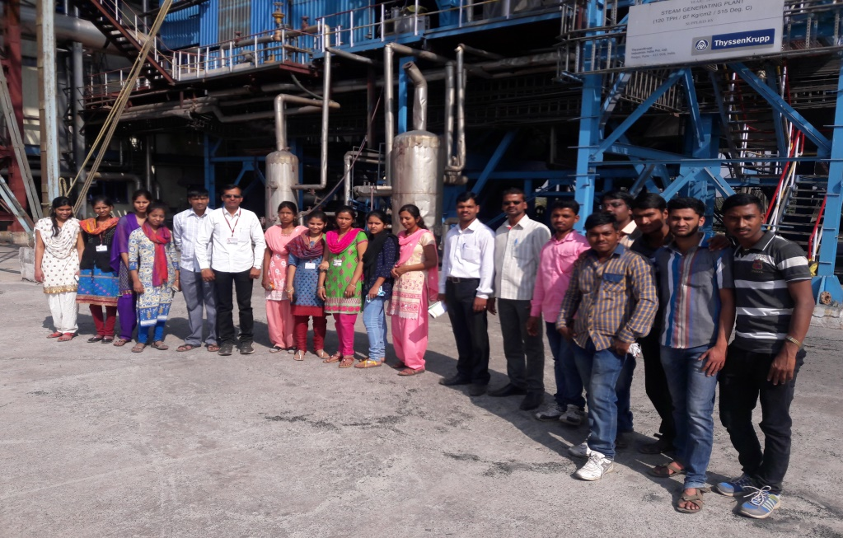
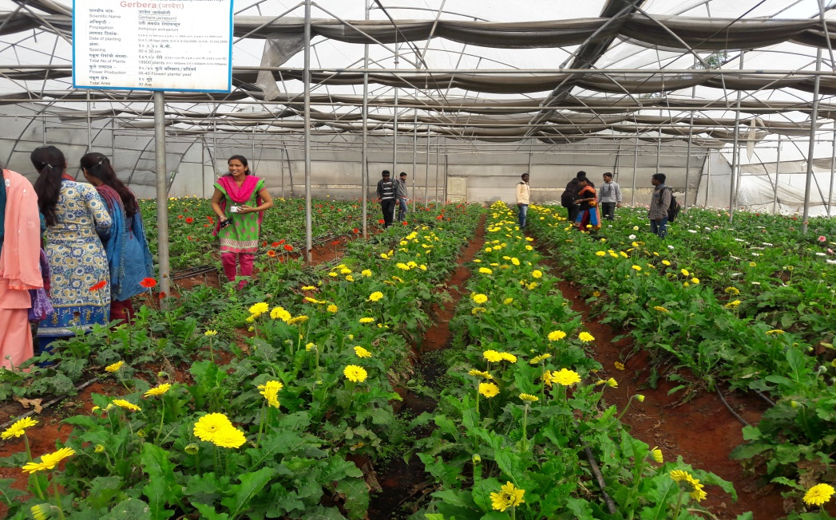
Year | Name of Activity | Date | Activity Details
2015-2016 | Study Tour | 22/1/2016 | Agriculture Exhibition, Kisan Veer Sugar Factory , Bhuinj

Slide 25
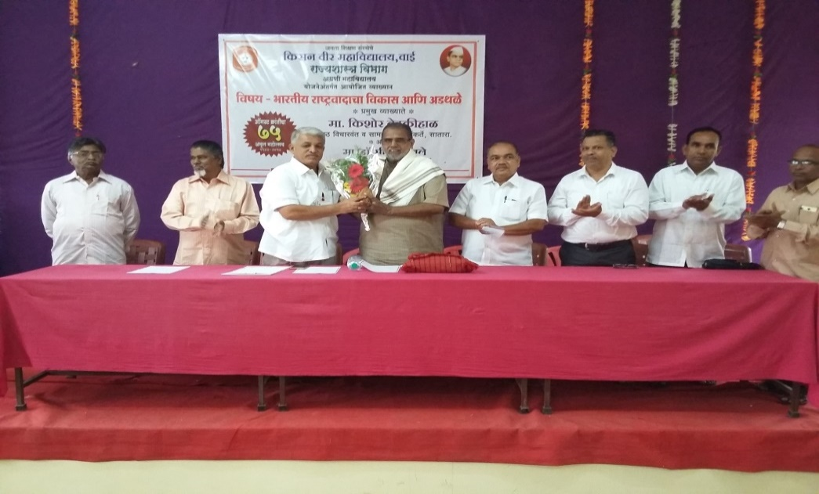
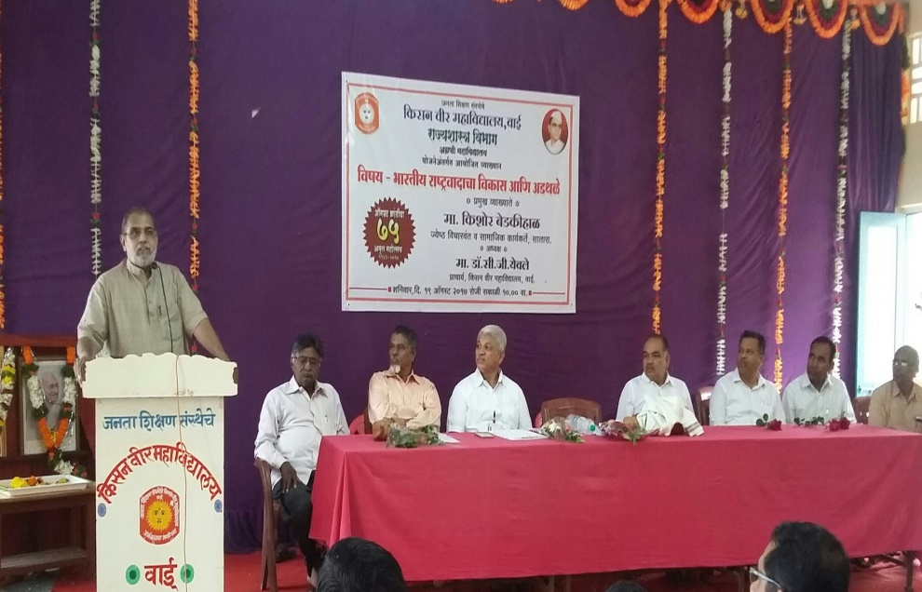
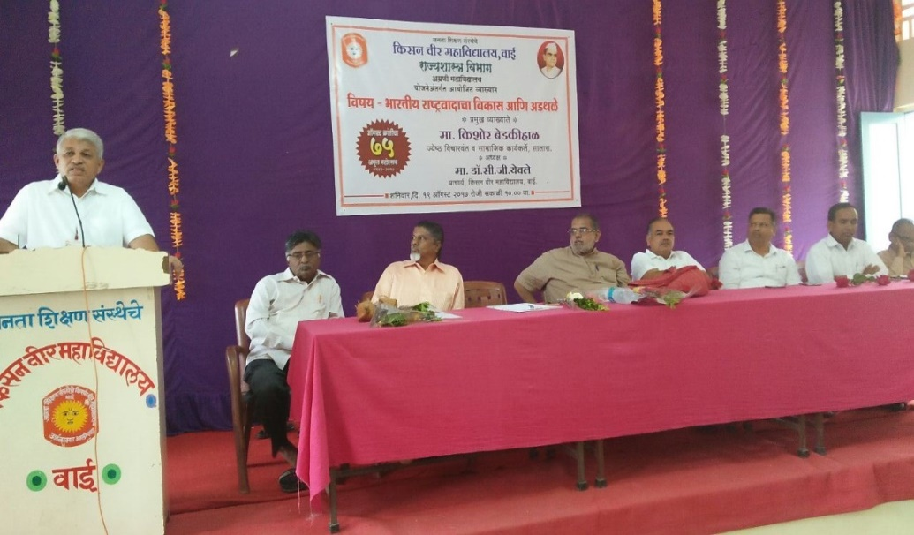
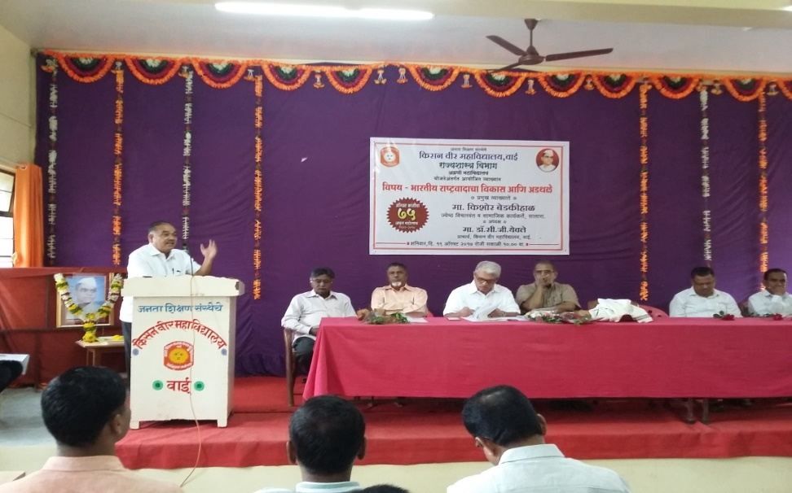
Year | Name of Activity | Date | Activity Details
2016-2017 | Guest Lecture | 09/08/2016 | Guest Lecture on August Kranti din

Slide 26
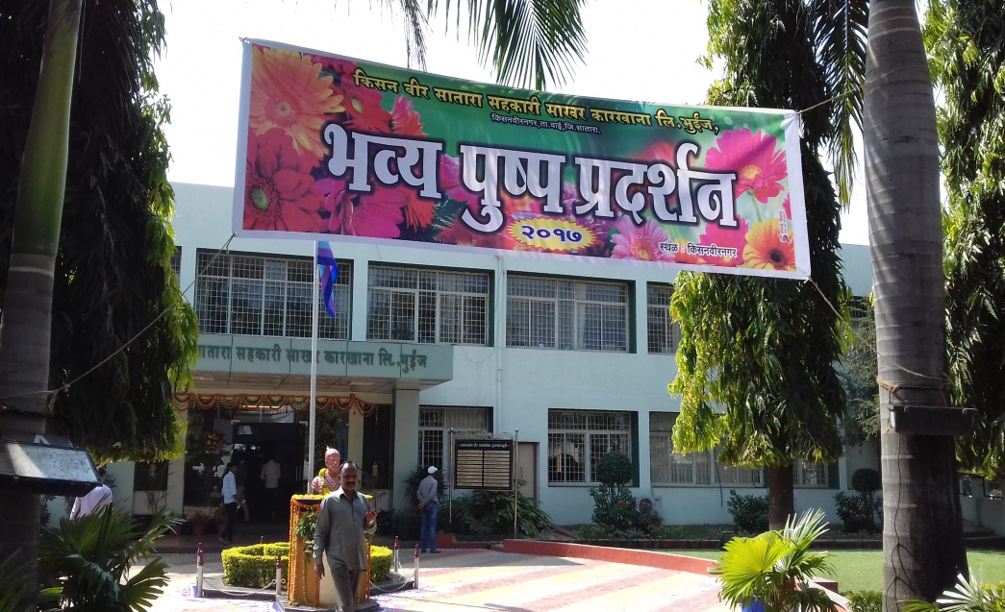
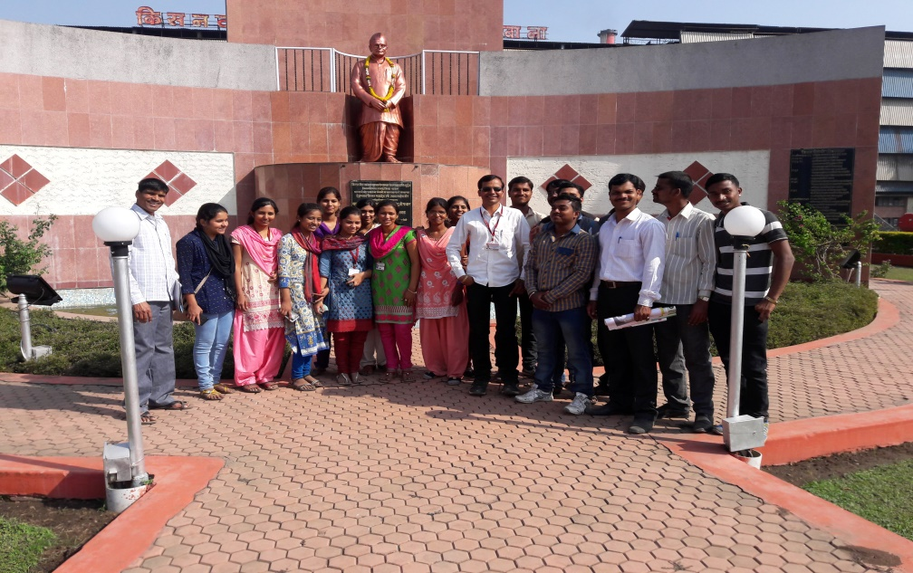
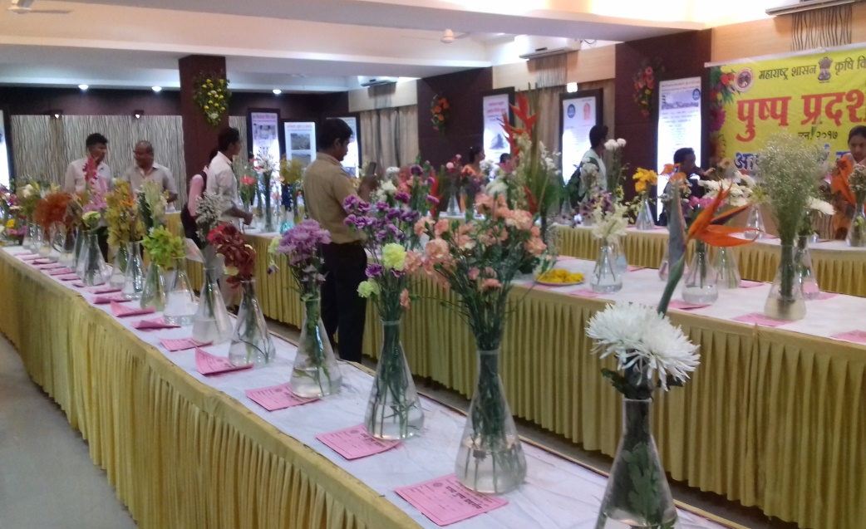
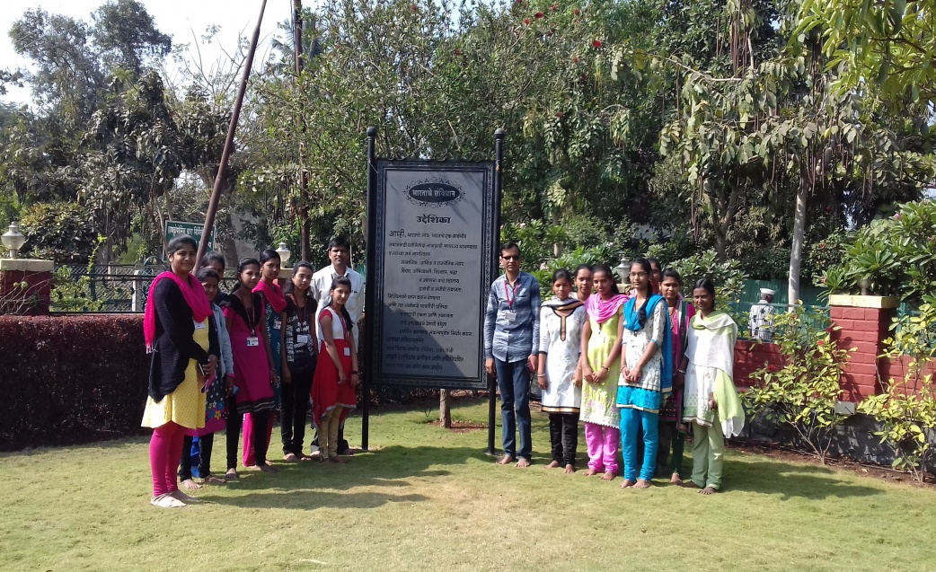
Year | Name of Activity | Date | Activity Details
2016-2017 | Study Tour | 23/01/2017 | Agriculture Exhibition, Kisan Veer Sugar Factory , Bhuinj

Slide 27
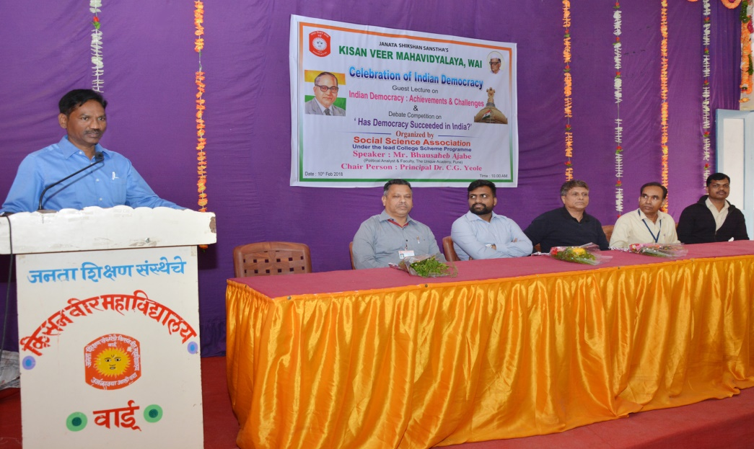
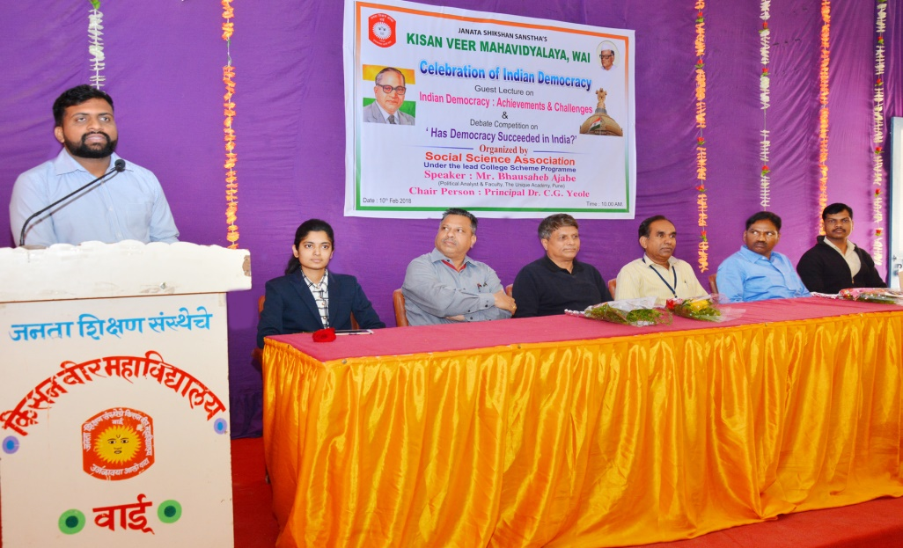
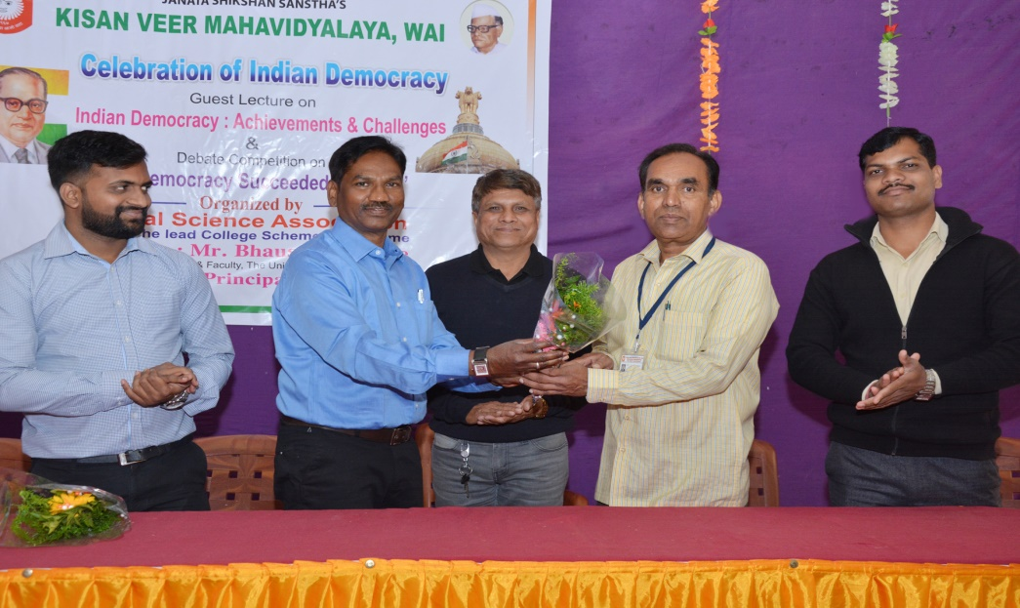
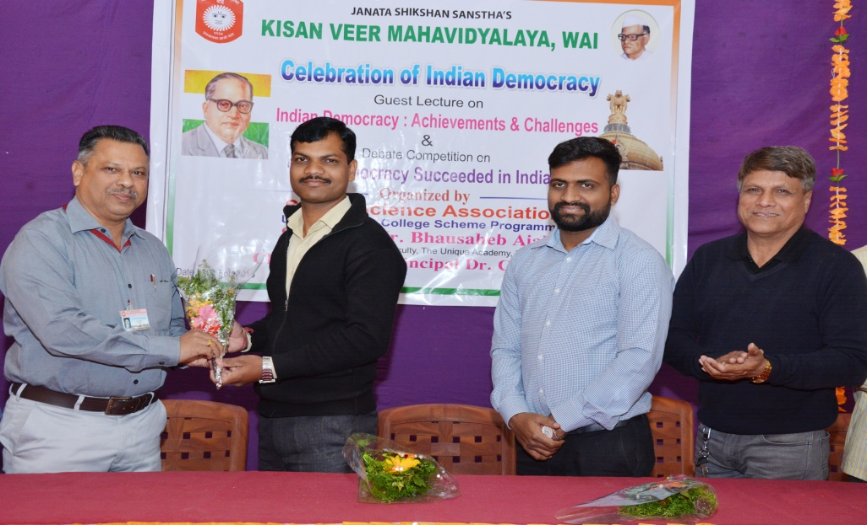
Year | Name of Activity | Date | Activity Details
2017-2018 | Guest Lecture | 10/02/2018 | Guest Lecture on the Indian Democracy

Slide 28
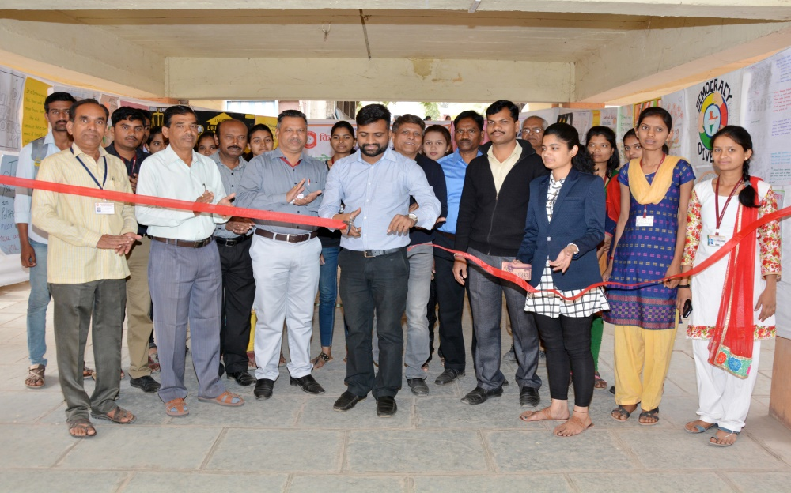
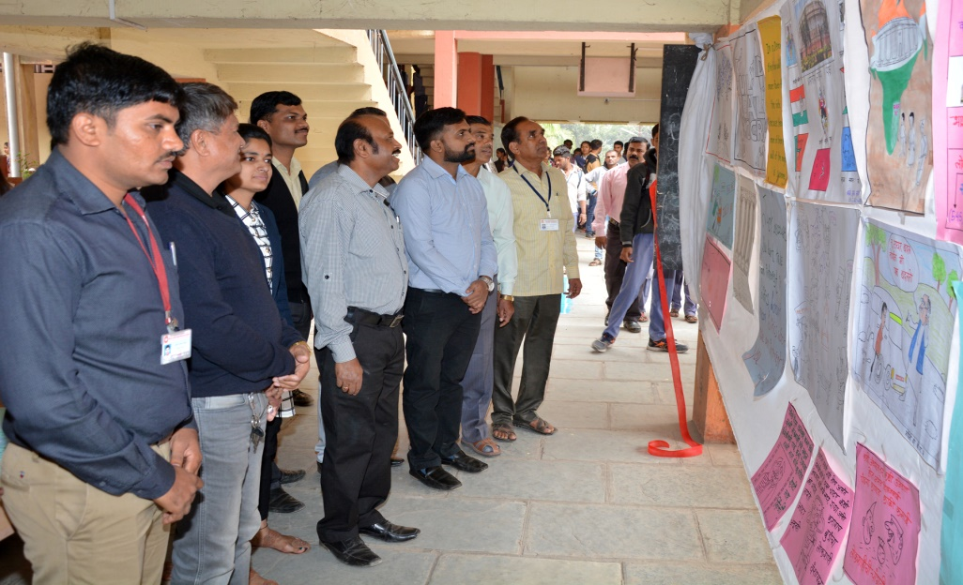
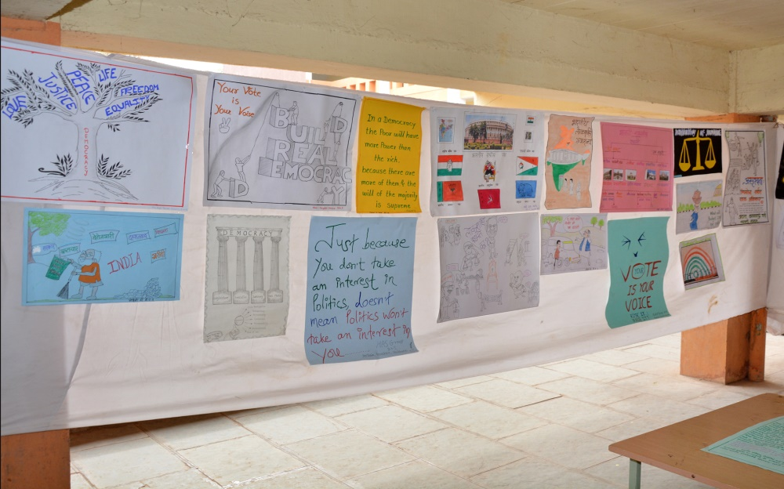
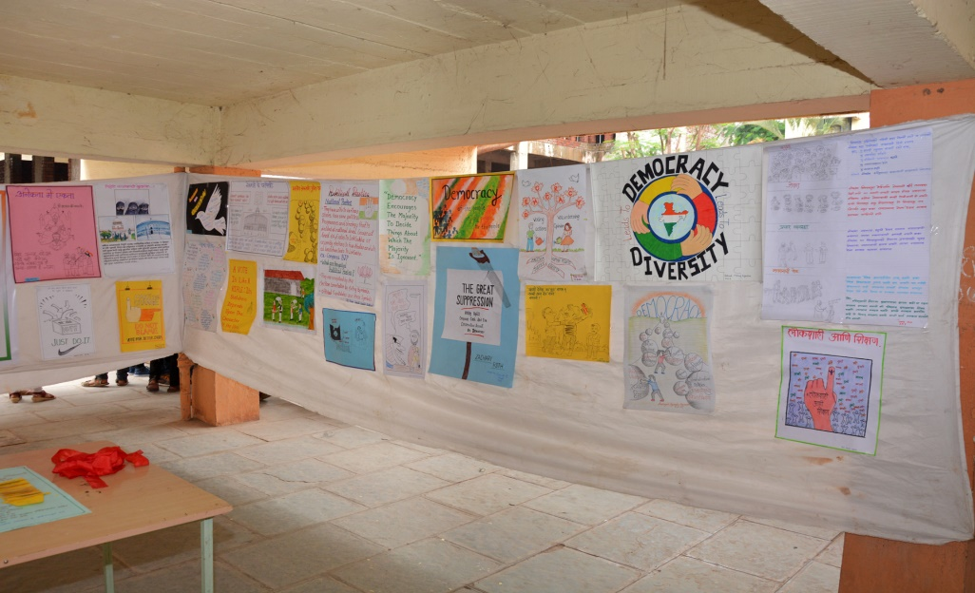
Year | Name of Activity | Date | Activity Details
2017-2018 | Poster Competition | 10/02/2018 | Poster Competition on the Democracy

Slide 29
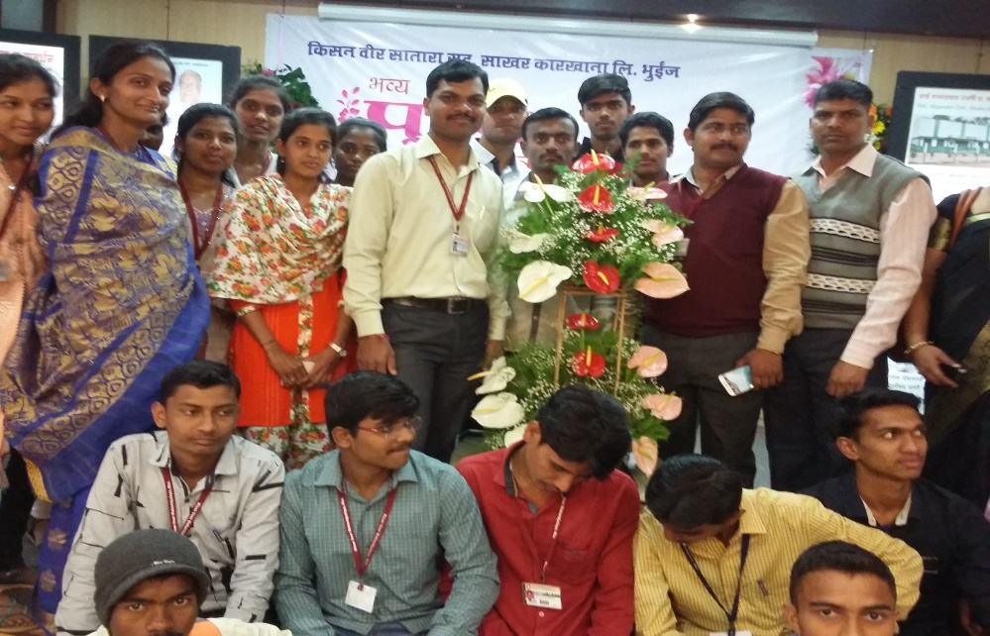
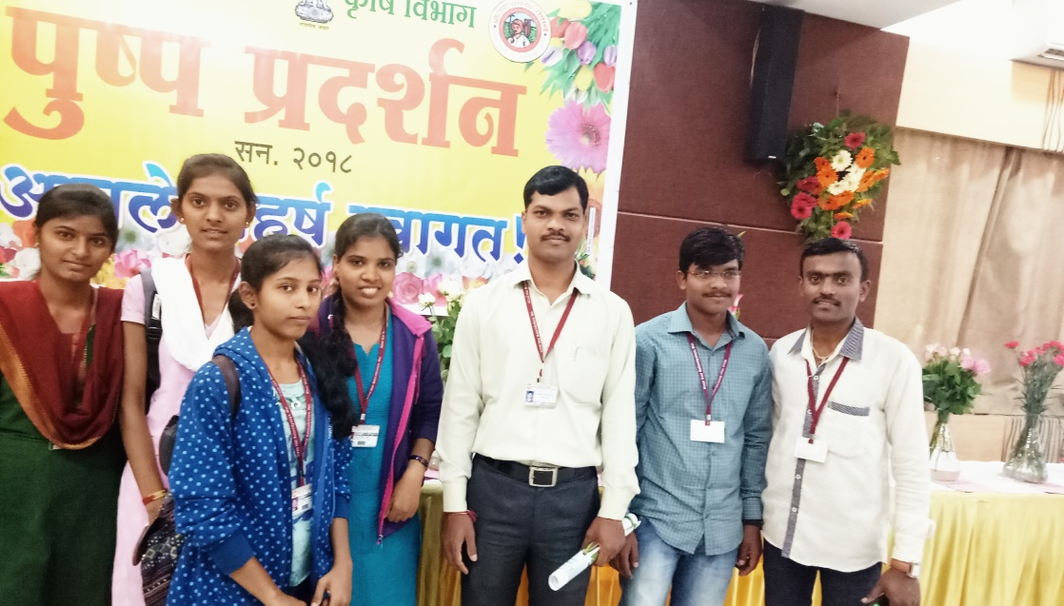
Year | Name of Activity | Date | Activity Details
2017-2018 | Study Tour | 222/01/2018 | Agriculture Exhibition, Kisan Veer Sugar Factory , Bhuinj

Slide 30
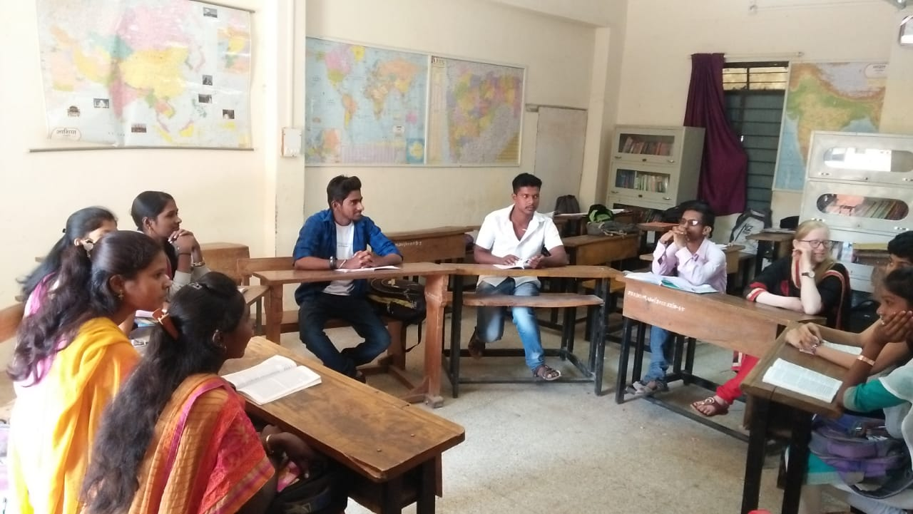
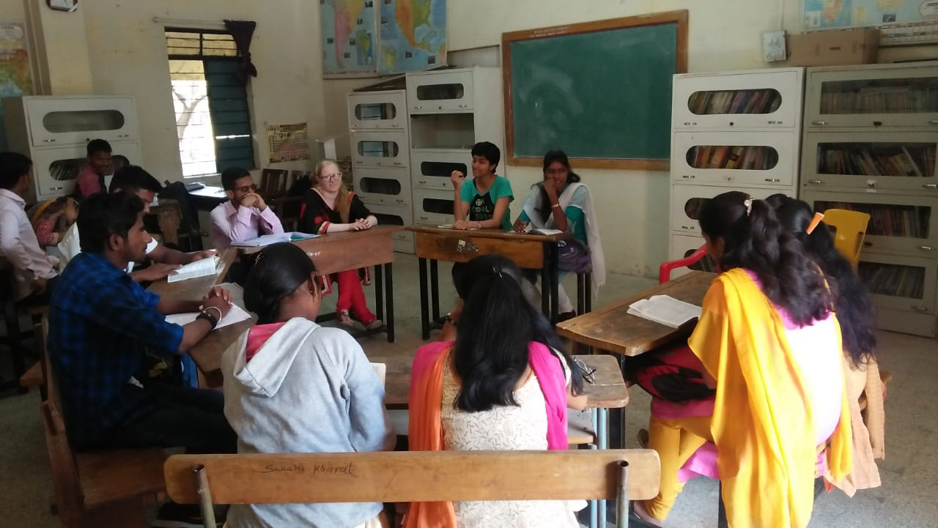
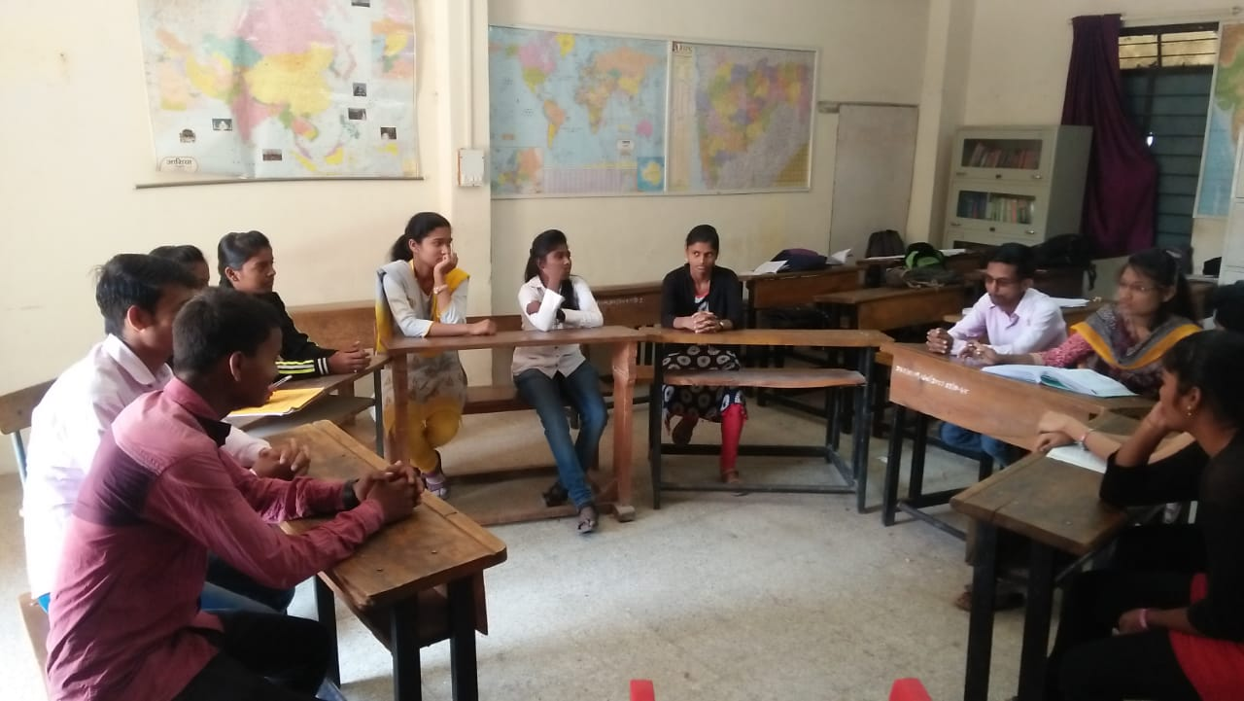
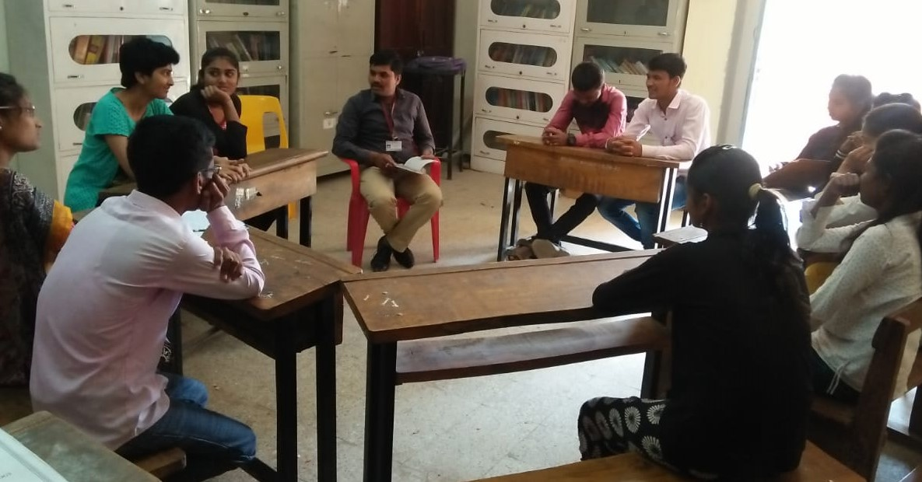
Year | Name of Activity | Date | Activity Details
2017-2018 | Group Discussion | 08/03/2018 | Group Discussion on Women Day

Slide 31
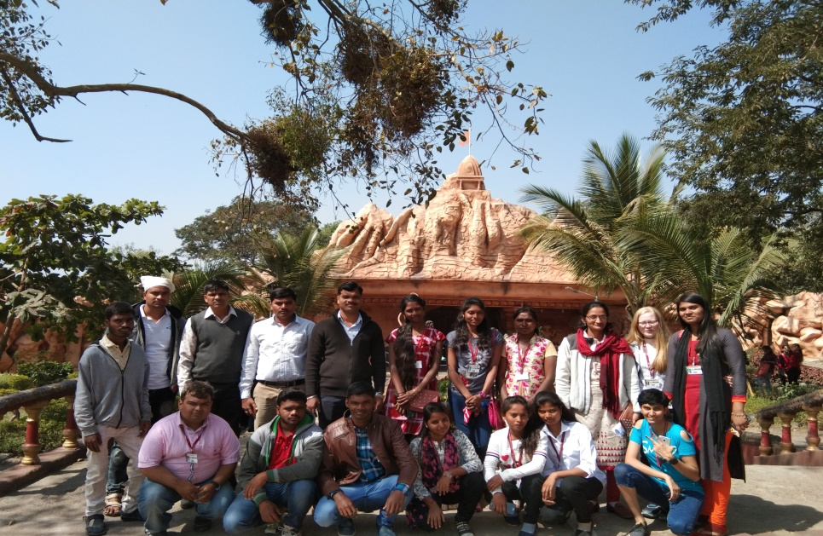
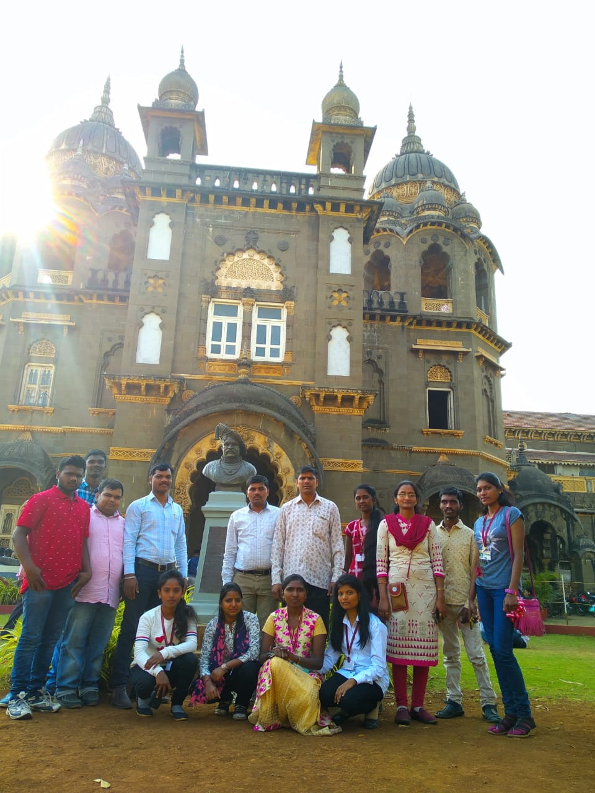
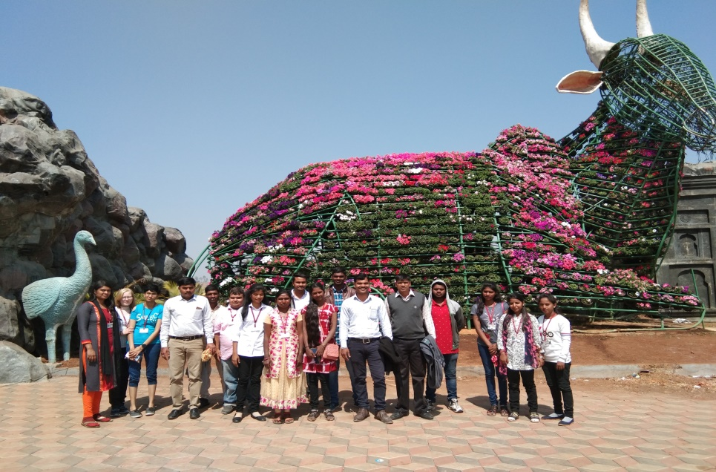
Year | Name of Activity | Date | Activity Details
2018-2019 | Study Tour | 10/2/2019 | Kolhapur Darshan

Slide 32
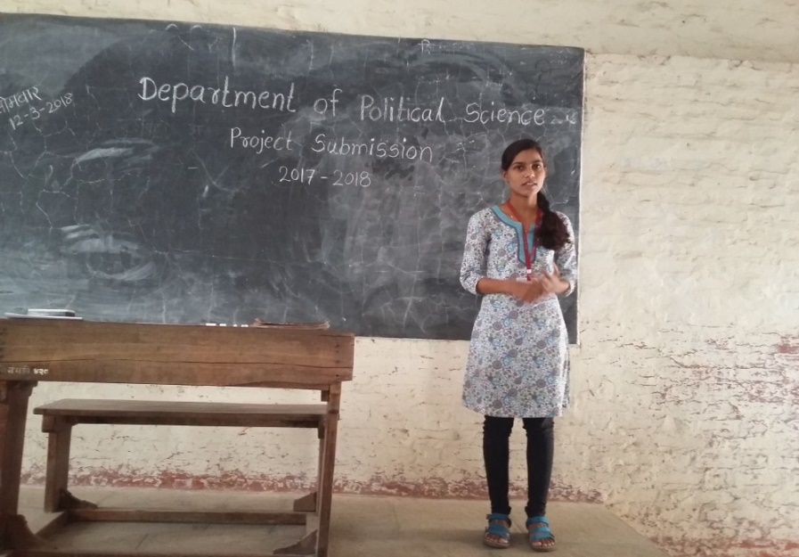
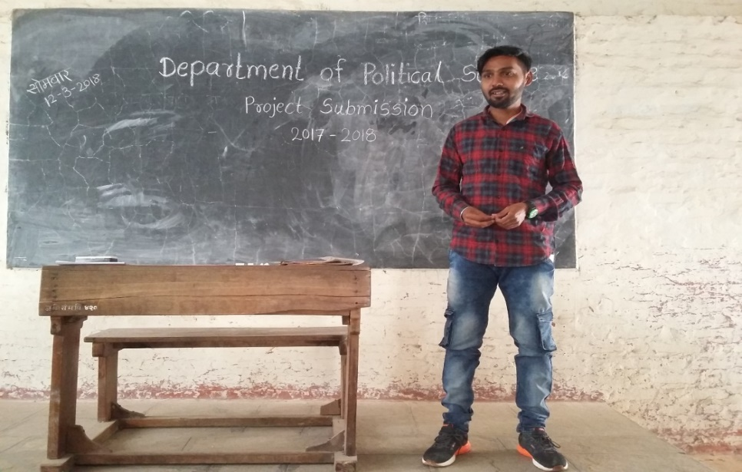
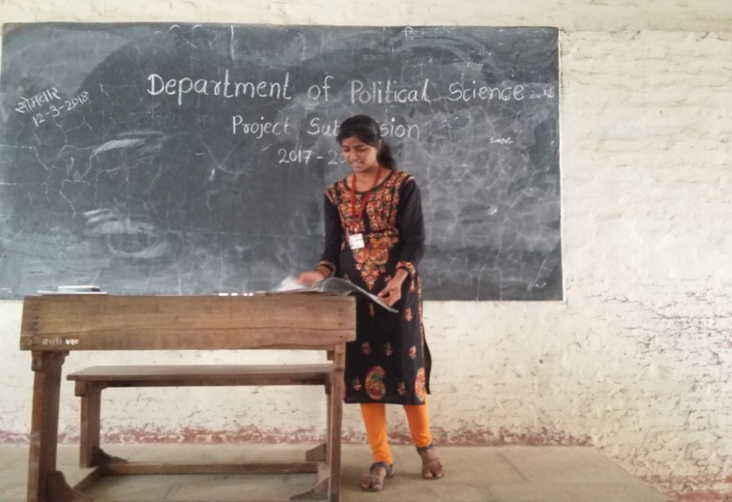
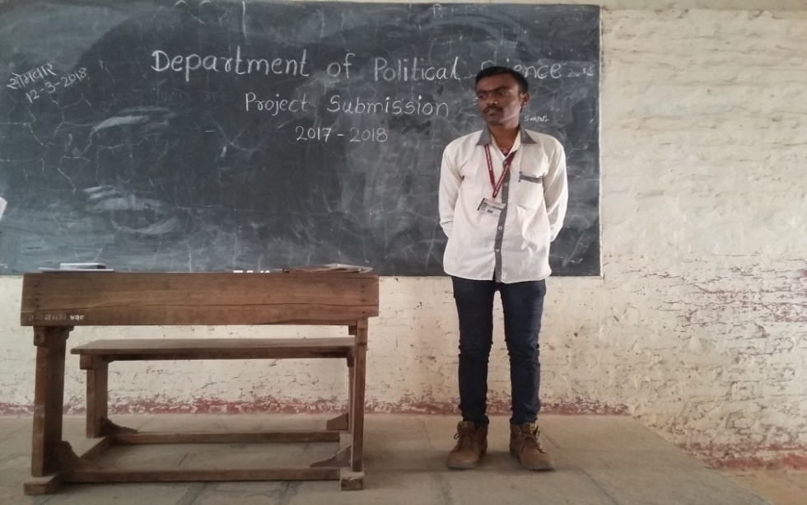
STUDENTS SEMINARS/ PROJECT SUBMISSION

Slide 33
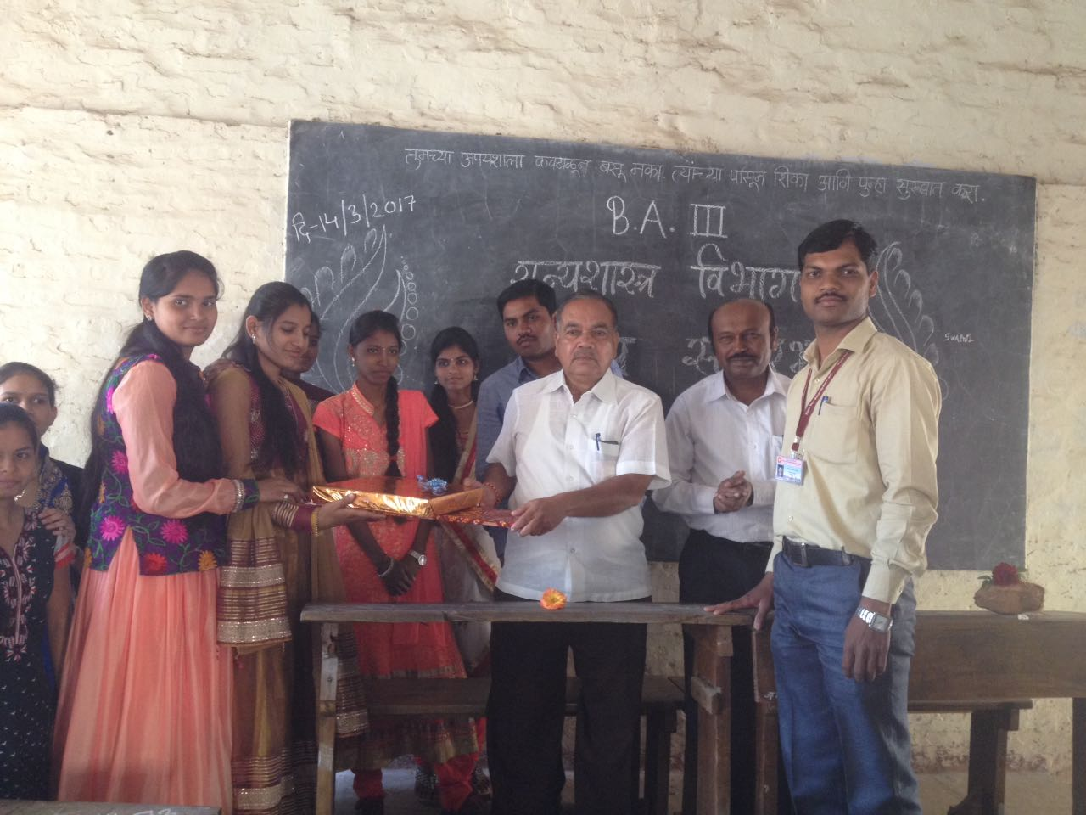
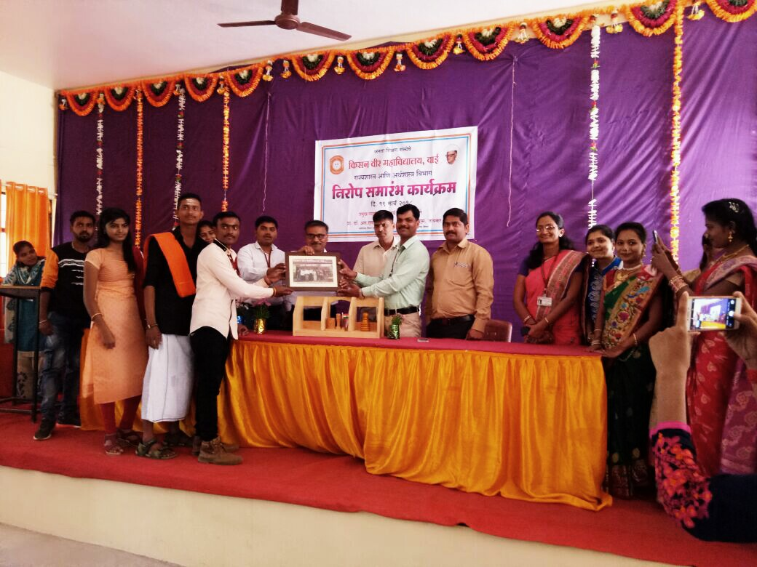
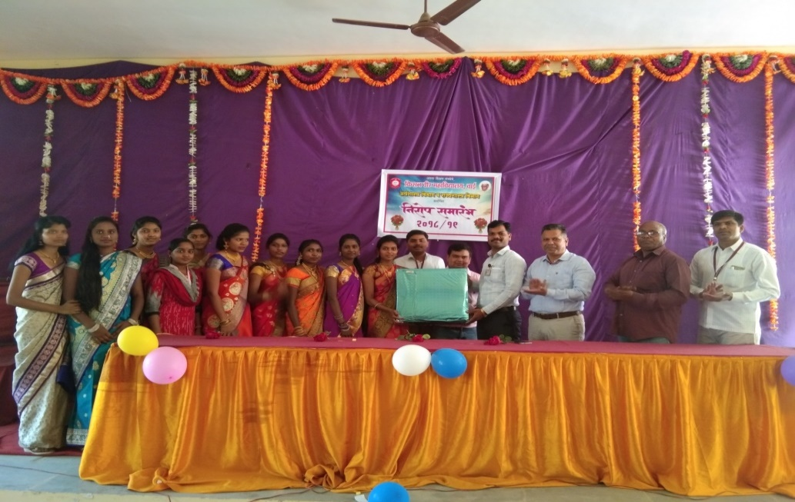
FAREWELL CEREMONY
2015-16
2016-17
2017-18
2018-19

Slide 34
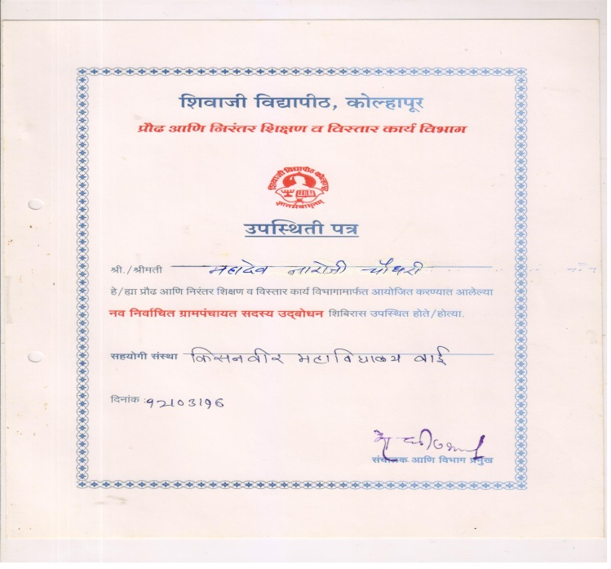
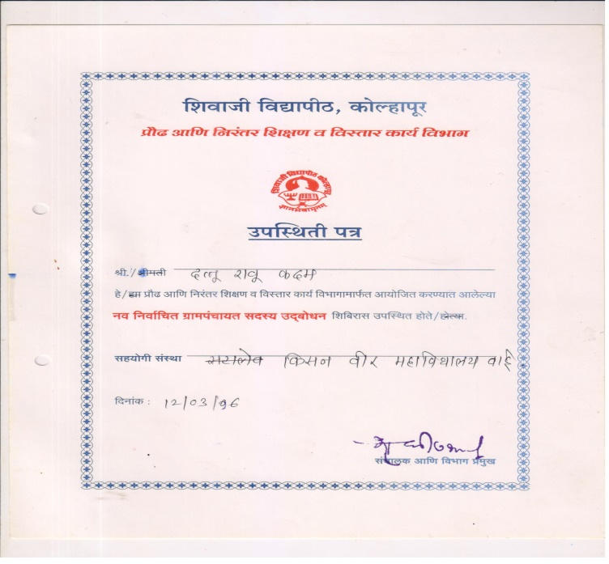
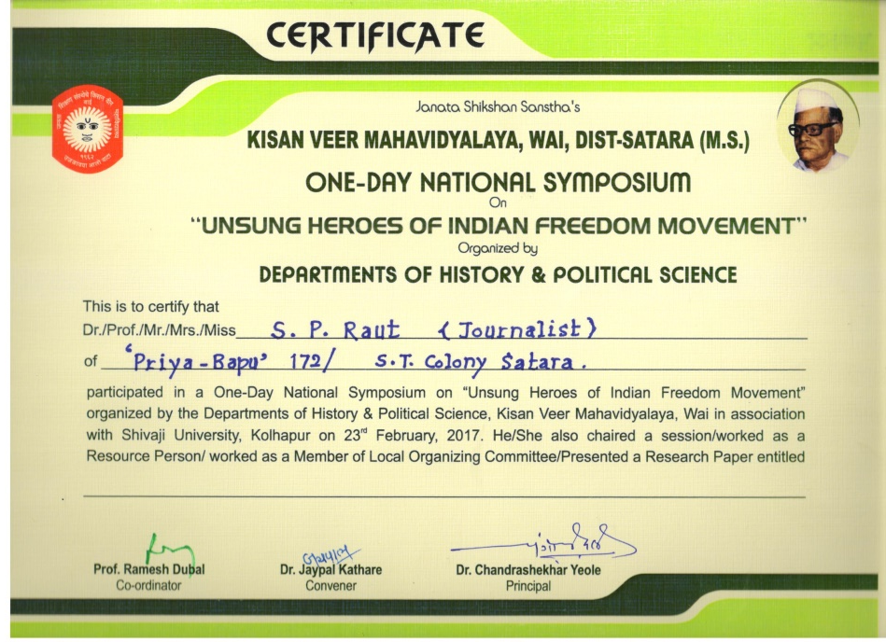
STUDENT PARTICIPATION IN CONFERENCES

Slide 35
PROGRAMME OUTCOME
After completion of the programme, the students will develop ability: To understand the major political system in the world. To interpret the role of regional and international organization in the new world order. To analyze the concept of good governance and e-governance. To realize the organs of government machinery and representation. To understand the formulation, execution, decisions and laws made by the government. To understand the Indian parliamentary political process. To make aware about social political, cultural and economic issues of the India and world. To understand the Indian constitution and its importance. To understand the importance of comparative study of the different types of systems in the world. To understand the working process of the Indian urban and rural local governments.

Slide 36
STUDENT PROGRESSION TO HIGHER EDUCATION:
Year | Sr.No. | Name Of the Student | Name of the Institution Joined | Name of Programme Admitted to
2013-14 | 1 | Dabhade Rahul Balkrushna | Shivaji University, Kolhapur. | M.A.
 | 2 | Jaigude Sagar Chandrakant | Chh. Shivaji College, Satara. | M.A.
2014-15 | 1 | Doke Baliram Shivaji | Kisan Veer Mahavidyalaya,Wai. | M.A.
 | 2 | Sawant Sagar Ramdas | Kisan Veer Mahavidyalaya,Wai. | M.A.
 | 3 | Khare Suyog Bhagvan | Shivaji University, Kolhapur. | M.A.
 | 4 | Mahangade Akash Dhananjay | Shivaji University, Kolhapur. | M.A.
 | 5 | Sonawane Shrikant Subhash | Shivaji University, Kolhapur. | M.A.
 | 6 | Pharande Jeevan | Shivaji University, Kolhapur. | M.A.
 | 7 | Kasurde Rajashree Atmaram | Shivaji University, Kolhapur. | M.A.
 | 8 | Chavan Poonam Gnanpat | Shivaji University, Kolhapur. | M.A.
2015-16 | 1 | Pinjari Azhar Hamju | Interior Designing College, Satara. | Diploma
 | 2 | Rewale Anjali Rajendra | Pune University, Pune . | M.A
 | 3 | Ghadge Komal Ganpat | Interior Designing College, Satara. | Diploma
2016-17 | 1 | Jadhav Rutuja Ramesh | Chh. Shivaji College, Satara. | M.A.
 | 2 | Chavan Pooja Rajendra | Chh. Shivaji College, Satara. | M.A.
 | 3 | Shingte Pallavi Sanjay | Chh. Shivaji College, Satara. | M.A.
 | 4 | Avadut Tejaswini Anil | Chh. Shivaji College, Satara. | M.A.
 | 5 | Mahangade Mayuri Hanmant | Chh. Shivaji College, Satara. | M.A.
 | 6 | Kharat Manisha Rajaram | Chh. Shivaji College, Satara. | M.A.
 | 7 | Kambale Suryakant Kiran | R.M. College. Akurdi, Pune. | M.A.
 | 8 | Karandakar Subhangi Dilip | Chh. Shivaji College, Satara. | M.A.
2017-18 | 1 | Suryawanshi Nilesh Sadanand | Shivaji University , Kolhapur. | M.A.
 | 2 | More Ketaki Vijay | A.T. College, Bhor. | M.A.
 | 3 | Jamdade Pratik Prakash | A.T. College, Bhor. | M.A.
 | 4 | Mali Sidharth Sambhaji | Chh. Shivaji College, Satara. | M.A.
 | 5 | Yadav Pratik Prabhakar | Chh. Shivaji College, Satara. | M.A.
 | 6 | Jagtap Deepali Gajanan | Chh. Shivaji College, Satara. | M.A.
 | 7 | Gaikwad Pooja Mohan | Chh. Shivaji College, Satara. | M.A.

Slide 37
PARTICIPATION OF FACULTY IN THE COLLEGE ADMINISTRATION
2013-14 | R.D.Dubal | Vice- Principal
 |  | Admission Committee (Member)
 |  | Discipline Committee (Member)
 |  | Lead College Committee (Co-ordinator)
 |  | Elocution &Essay Competition (Member)
 |  | Building Maintenance (Member)
 |  | Alumni Association (Member)
 |  | Building Committee (Member)
 |  | Canteen Committee(Co-Ordinator)
 |  | Ladies Hostel Management (Member)
2014-15 |  | Vice- Principal
 |  | Prospectus Committee (Member)
 |  | Gymkhana & sport (Member)
 |  | Lead College Committee (Co-Ordinator)
 |  | Grievance Redressal Cell (Member)
 |  | Anti-Ragging Committee (Member)
2015-16 |  | Gymkhana & sport (Member)
 |  | Grievance Redressal Cell (Member)
 |  | Lead College Committee(Co-Ordinator)
 |  | Anti-Ragging Committee (Member)
 |  | Building Committee (Member)
 |  | Canteen Committee (Member)
2018-19 | R.S.Jaykar | Competitive Exam Committee (Member)
 |  | Social Science Association (Member)
 |  | NCC Advisory Committee (Member)
 | K.A.Kajale | Discipline Committee (Member)
 |  | Social Science Association (Member)

Slide 38
SWOC
WEAKNESSES
ICT based lab for research
Organization of seminar/conferences
Permanent Faculty at Department
STRENGTHS
Qualified and experienced faculty
Participation of students in seminars/conferences
Organized field visits, industrial visits and study tours
Certificate course in Political Science for Competitive Exam
Consistent and excellent academic performance
Organized institutional level workshops and guest lectures
OPPORTUNITIES
To start P.G department
To start Capsule course in ‘Fundamentals of Citizenship’ for the Multi faculty Students
To organize collaborative activities in association with Economics, History, Geography, Psychology .
CHALLENGES
To provide job opportunities for students through campus placements
To adopt the advanced technologies in teaching and learning
Week financial status of students

Slide 39
BEST PRACTICES
Organization of National level Symposium
Organization of Guest lectures
Field visits, industrial visits and study tours.
Certificate course in Political Science for Competitive Exam
Participation of students in seminars/ conferences
Organization of parent meet

Slide 40
FUTURE PLAN
To start Capsule course in ‘Fundamentals of Citizenship’ for the Multi faculty Students
To organize workshops/ Conferences/Seminars
To start Postgraduate Course in Political Science
Every year visit to Parliament for special students
To start Certificate course in Journalism

